Slide 1
Cloud Native Ops Workshop
PCF Architecture and Operations
Version 1.0
March, 2019

Slide 2




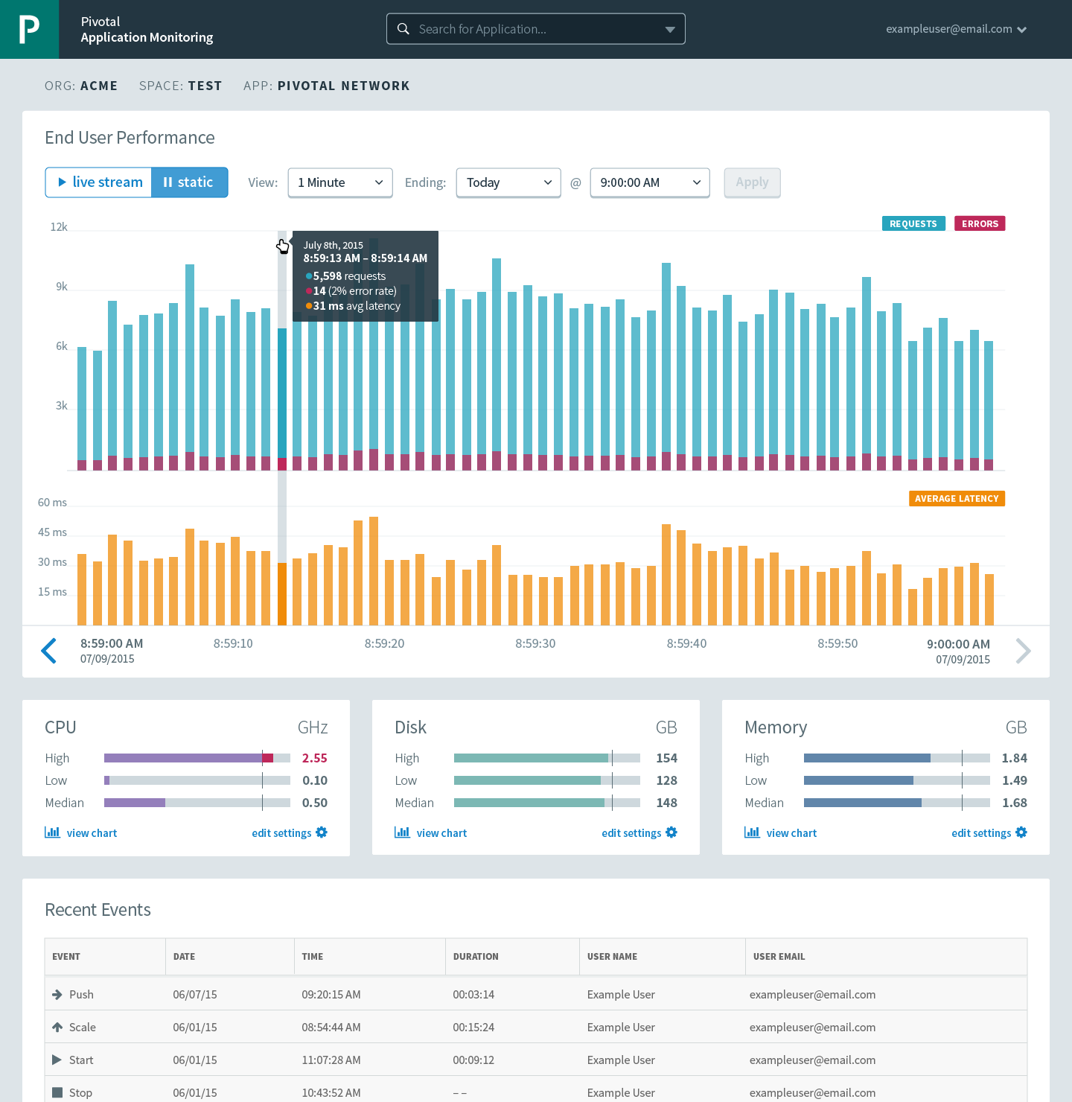





Cloud Foundry: An Application-centric Platform
Mobile Services
Centralized Log Management
Networking
& Load Balancing
Auto-Scaling
APM & Tracing
APPLICATION
Health management
Full Stack CI/CD platform
Notes:
Your Application is the Center of the universe!
Cloud Foundry takes care of the rest. Everything you need to deliver software is builit into this platform such as…. It changes the way applications and services are deployed and run by reducing the develop to deployment cycle time. And Devops culture enables the overall ownership there for allows teams to do what’s best for the applications, and therefore what’s best for the business, so not only your application is more robust, it can constantly adapts to changing environmental.
So Spring Boot/Cloud meant create apps fast – But Dev & Ops is asking Day2 questions -
How do you do logging, routing, apm, scaling, and lifecycle management of all these apps.
Enter CF Runtime
best in class container management
integrated agentless logging
with APM
auto scaling
Effortless runtime with minimum human operational overhead. We run 1000s of apps and 10,000s containers on PWS with 6 guys.
But we realized that stopping there wasn't enough

Slide 3



Cloud Foundry Haiku
Here is my source code
Run it on the cloud for me
I do not care how
Notes:
Best way to summarize cloud foundary experience for developers. Here is the famous CFH.
a Japanese poem of seventeen syllables, in three lines of five, seven, and five

Slide 4


CF PUSH Demo
Notes:
Push an App, show the logs

Slide 5

Pushing an Application
Platform Runtime (Elastic Runtime)
Blobstore
Service
credentials
Upload app bits and metadata
DB
push app
+ app MD
Cloud Controller
Service Broker Node(s)
Create and bind services
Stage application
Deploy application
Manage application health
Router
Container Management - DIEGO
Cell
DEA
Brain
DEA
DEA
+
=
Notes:
Talk and click through how applications are deployed and all of the manual effort that is automated underneath the hood.
Cloud Foundry PaaS – Pushing an Application with Diego
App deployment: what has changed?
1- Domain specific (notion of apps) -> Abstractions (notions of LRPs and Tasks). App staging is a Task. App start is launching a LRP.
2- Platform specific (Linux) -> Supporting multi platform (Windows & Linux) enabling running also .NET apps, thanks to our new Container implementation: Garden
What’s more, there is a 3rd workflow supported: Docker on Linux
3- New Auction-based workload scheduler: Cloud Controller no longer in charge of deciding where AIs are spun up. Auctioneer manages the process running an auction, making it more optimized.
With Diego in place, more loosely-coupled components take part in the process, stripping down the Cloud Controller from too many previous responsibilities, making it easier to maintain and evolve the entire architecture.
The Cloud Controller handles the routing of client requests internally through the Cloud Controller Bridge. It also manages the Blobstore to store packages and droplets and the DB to store App Metadata and Service credentials. Blobstore could be internal or external, depending on the setup.
A service gateway provides an interface for services (native or external).
More in the next slide about the Cloud Controller Bridge (CC-Bridge), the Bulletin Board System (BBS) and the Auctioneer in the next slide
Apps run in a CELL, part of the new Cloud Foundry Runtime, called Diego
Routers manage application traffic.
Diego handles all health management for apps (now LRPs), through a series of single-purpose components: Nsync (part of the CC-Bridge), BBS (part of Diego DB) and the Converger (part of the Diego Brain)
Apps are accessed directly through the router while web and CLI clients (e.g., vmc, STS) access Cloud Controller via RESTful services.

Slide 6
Staging and Buildpacks
Buildpacks are responsible for preparing the machine image for an application.
}
Application
Buildpack
Container
Libraries
Droplet
CELL
Runtime
Operating System

Slide 7
Buildpack Flavors
Buildpacks installed into a Cloud Foundry instance or loaded from an external location at app deployment time
Buildpacks provided by public Cloud Foundry
Modify existing buildpacks or write your own
Java
Ruby
Node.js
Binary
Go
Python
PHP
Staticfile
.NET
.NET Core
Notes:
Java
Ruby
Node.js
Custom Build packs

Slide 8
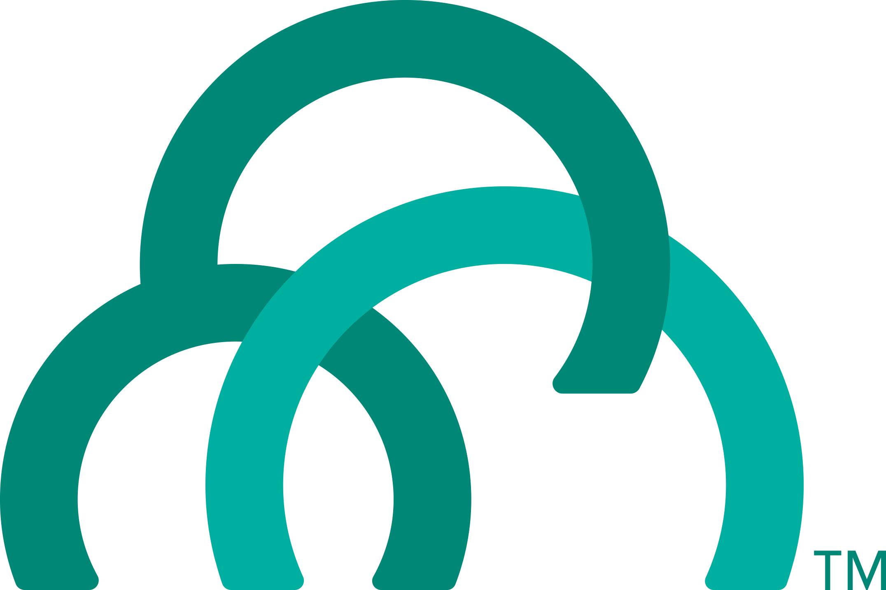
Staging an Application
Staging Request
Task
Blobstore
Cloud Controller
Cloud Controller Bridge
BBS / etcd
Service
credentials
CELL Auction
Brain
DB
Auctioneer
Router
CELL
System
Buildpacks
Detect
Compile
Upload
No
Yes
Python
+
=
Java
Runtime

Slide 9

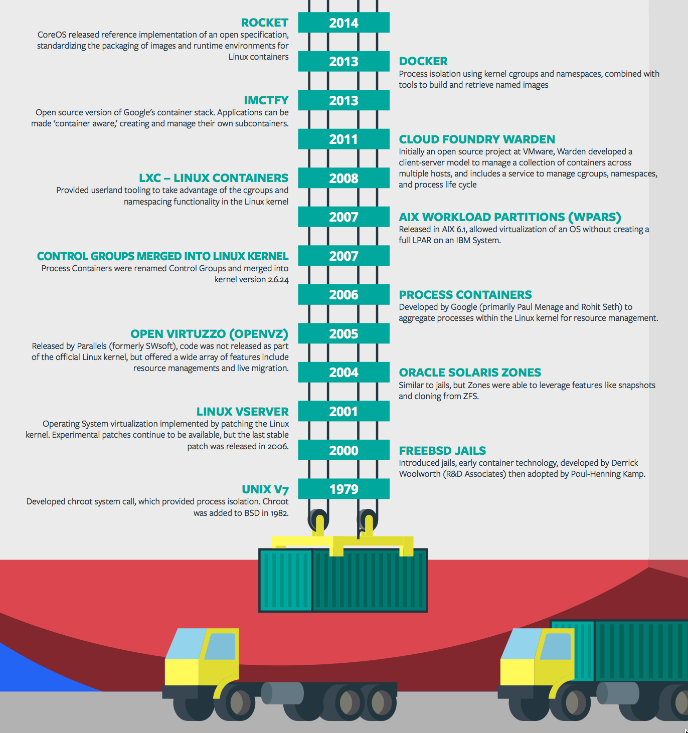
Containers - History
CONTAINERS!!!!
Containers are not new
CF has used containers since it’s inception
CF supports multiple container technologies as first class citizens including Docker, Warden, Garden and runC
Notes:
History of Docker
- 2006 Google to use containers they built cgroups and namespaces and pushed it to the Linux kernel
- cgroups and namespaces give you isolation (Resource Isolation and Namespace isolation)
- dotCloud and LXC fragmentation
- libcontainer created to address application portability and standard API across linux distros BUT controlled by Docker
- Open Container Project (Docker/dockerfile, CoreOS/appc). Standardiized on runC
- Standardizing the file format (dockerfile + appc = filesystem)
- Standardizing the runtime (libcontainer = runC)
- Container (Isolation + Files/metadata + Processes)

Slide 10
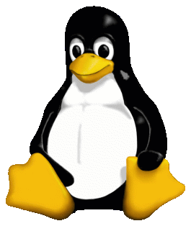
Container Isolation
shared resources
resource isolation
kernel
namespace isolation
Cell
process F
process A
process E
process B
process D
process C
tenant 1
tenant 2
tenant 3
Notes:
----- Meeting Notes (2/10/16 13:49) -----
modify to represent the cell, and change tenants to containers

Slide 11


Container Isolation
CPU
resource isolation
namespace isolation
cgroups
process D
process F
process F
process E
process A
process E
process B
process D
process C
A Linux kernel feature that limits, accounts for, and isolates the resource usage of a collection of processes
tenant 1
tenant 2
tenant 3
Notes:
Cgroups - A Linux kernel feature that limits, accounts for, and isolates the resource usage of a collection of processes
----- Meeting Notes (4/20/16 11:43) -----
Add on to extend a VM?

Slide 12
Container Isolation
PID
2
3
4
2
2
3
resource isolation
namespace isolation
PID namespace
process F
The PID namespace provides isolation for the allocation of process identifiers (PIDs), lists of processes and their details.
process A
process E
process B
process D
process C
tenant 1
tenant 2
tenant 3
Notes:
PID namespace - provides isolation for the allocation of process identifiers (PIDs), lists of processes and their details.

Slide 13
Customize the Container Experience
Buildpacks
Containers
Developer brings customized app
Developer brings customized app
Platform buildpacks provide standard runtime*
Developer brings runtime container image
Platform provides fixed OS container image
Developer brings container OS image
Platform provides fixed host OS Kernel
Platform provides fixed host OS Kernel
App container
* Devs may bring a custom buildpack

Slide 14
Containers and Scaling
Overview
Notes:
So how many people in here have heard of BOSH?
BOSH is the cloud foundry platform orchestration engine
This is the same BOSH used in open source cloud foundry, making Pivotal, the closest platform to the original CF!
Then you also know how tedious it can be to manage orchestration via manifest files, hence we created Ops Manager to make an easy way to work with it.
http://bosh.io/docs/about.html
https://bosh.io/docs/bosh-components.html

Slide 15
D e m o
Notes:
Scale an app

Slide 16
Application Containers and Scaling
LRP
Deploy Request
LRP
Scale Request
Blobstore
Cloud Controller
Cloud Controller Bridge
BBS / etcd
Access App
Service
credentials
CELL Auction
Brain
DB
Auctioneer
Router
Converger
CELL
CELL
CELL
Desired
Actual
Executor
Rep
Executor
Rep
Executor
Rep
Runtime

Slide 17
Domains and routes
Notes:
THIS SECTION INCORPORATES SLIDES FROM “PCF Basics and Arch 301” Deck

Slide 18
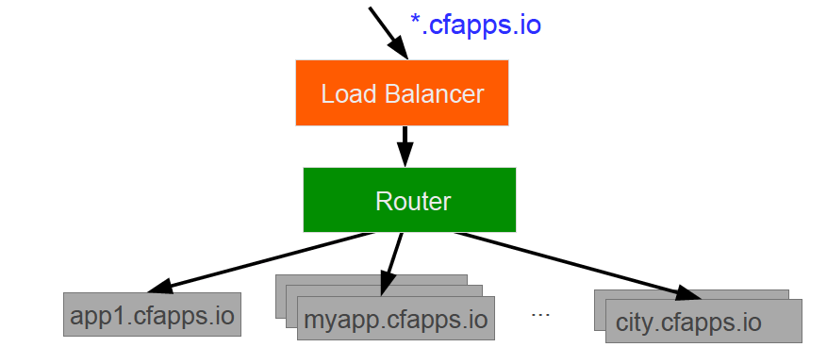
Domains – Behind the Scenes
A entry is added to the DNS for the app domain
That DNS entry points to a load balancer (LTM) which points to the Cloud Foundry’s Router
The Router uses the subdomain or ctx path to map to application instance(s)
Notes:
https://docs.pivotal.io/pivotalcf/devguide/deploy-apps/routes-domains.html
Picture of PCF architecture HAProxy and Router using domain namesdns

Slide 19
Zero Downtime
Blue-Green Deployment
myapp.cfapps.io
App Version1
App Version2
Live Traffic
Live Traffic

Slide 20
LOgging
Notes:
THIS SECTION INCORPORATES SLIDES FROM “PCF Basics and Arch 301” Deck

Slide 21
D e m o
Notes:
“Anatomy of a Buildpack”
Show students a buildpack repo and discuss OSS CF and how each language has a buildpacks that knows how to detect the language as well as compile the droplet.
https://github.com/cloudfoundry/python-buildpack
Compile
Detect: https://github.com/cloudfoundry/python-buildpack/blob/master/bin/detect
Release:

Slide 22
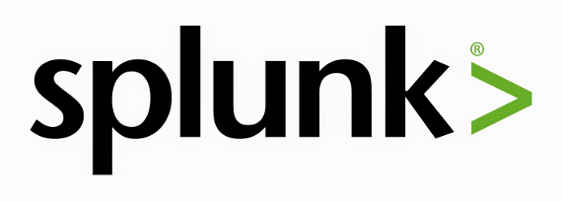
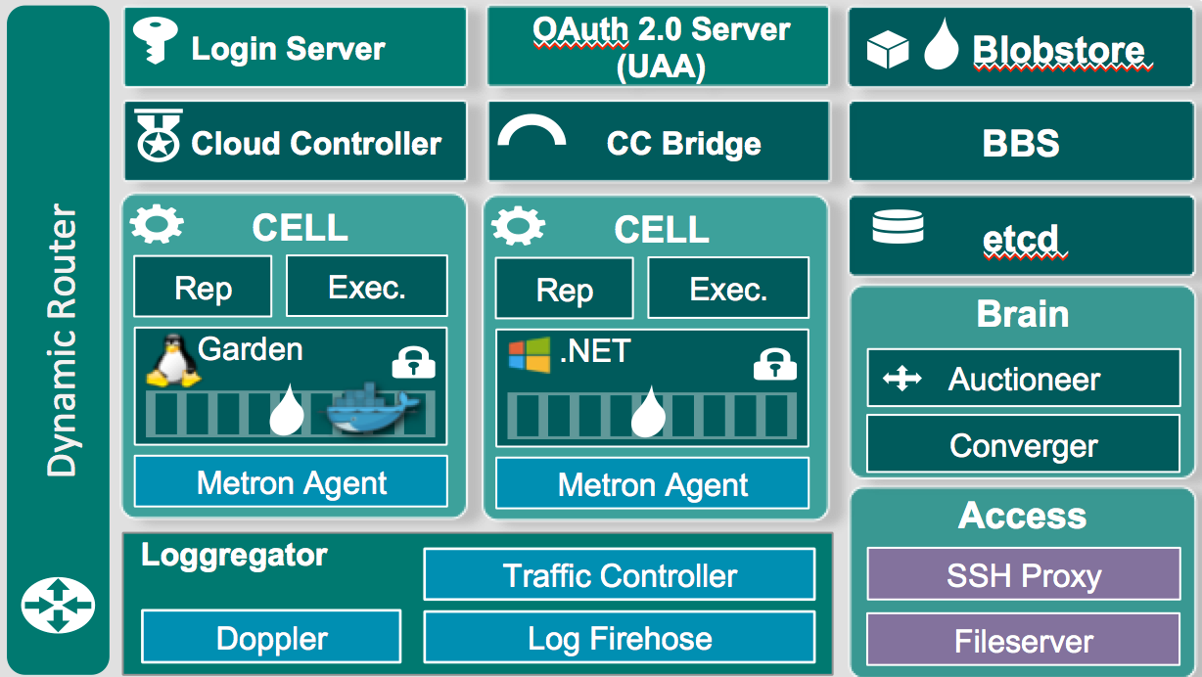
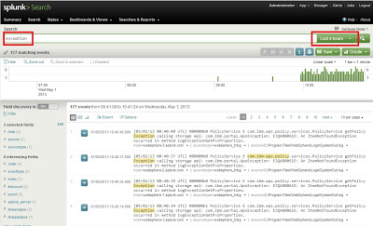
Stream application logs
Notes:
Need to install a plugin so Splunk can read CF logs properly
Note this isnt showing a full Splunk Arch

Slide 23
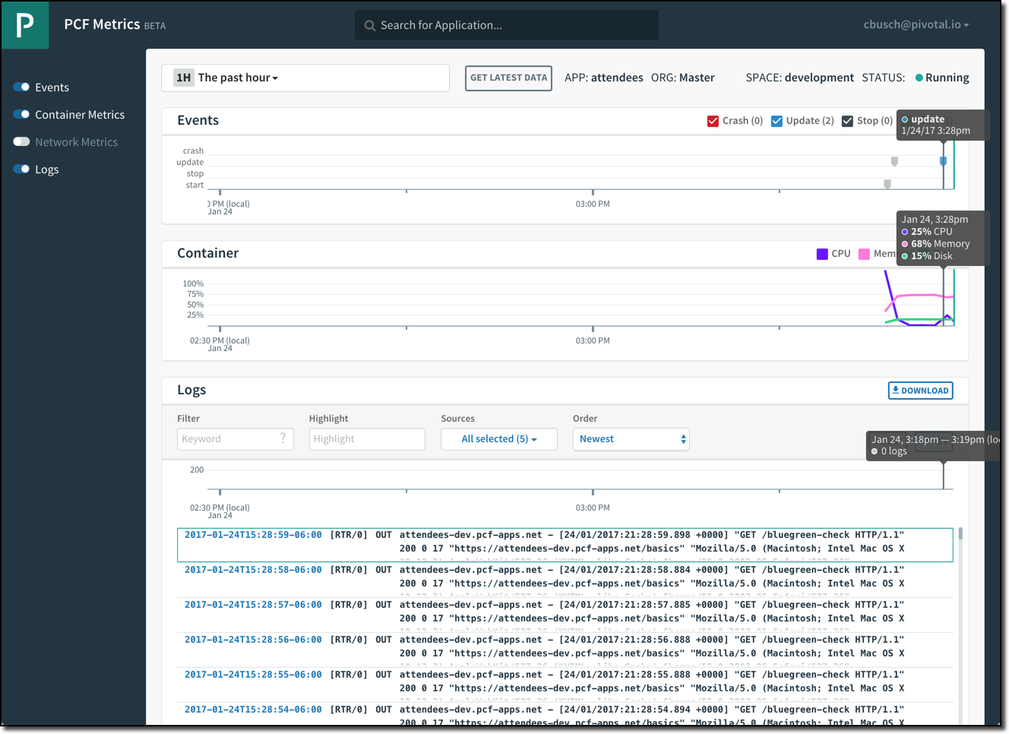
PCF Metrics
Application events
Container metrics
Application logs

Slide 24
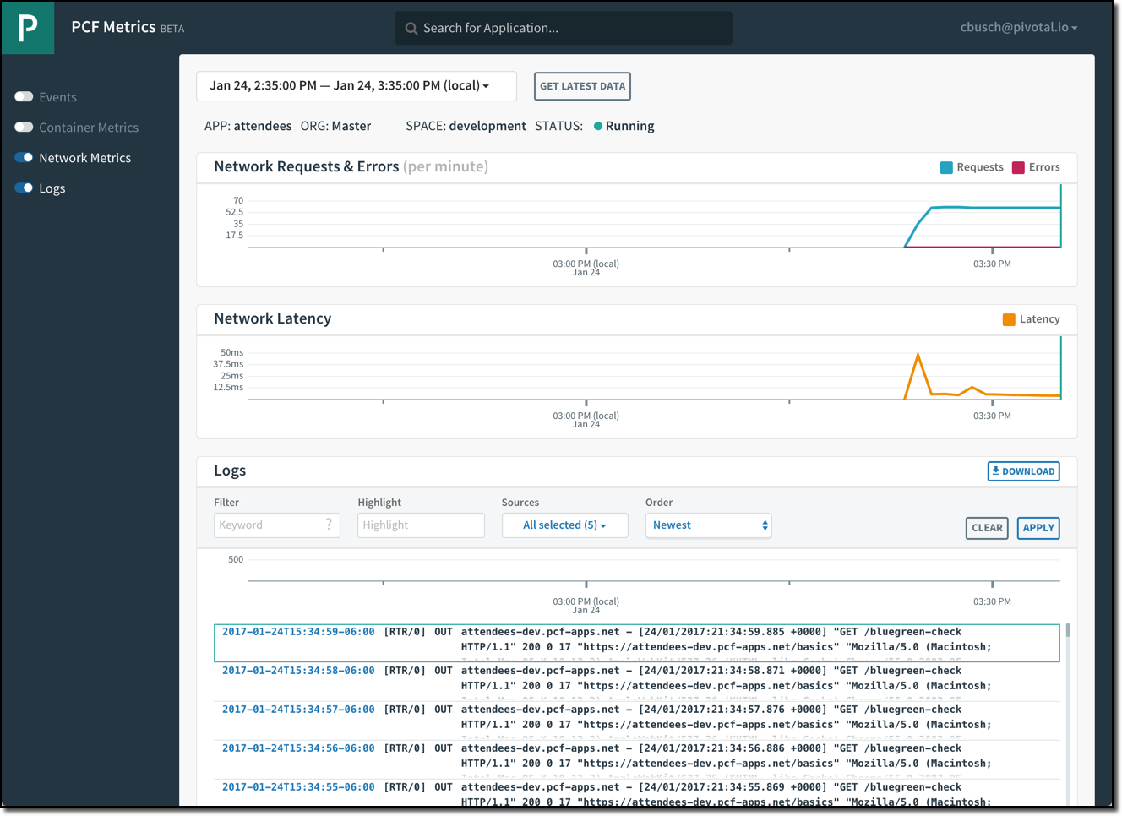
PCF Metrics
Networking metrics
Application logs

Slide 25
Application Performance Monitoring
PCF Metrics provides a real-time application monitoring dashboard
3rd Party Tiles provide in-depth monitoring of applications running on PCF via an embedded agent bundled with applications that are deployed using Buildpacks
New Relic
AppDynamics
Dynatrace

Slide 26
Services
Notes:
THIS SECTION INCORPORATES SLIDES FROM “PCF Basics and Arch 301” Deck

Slide 27
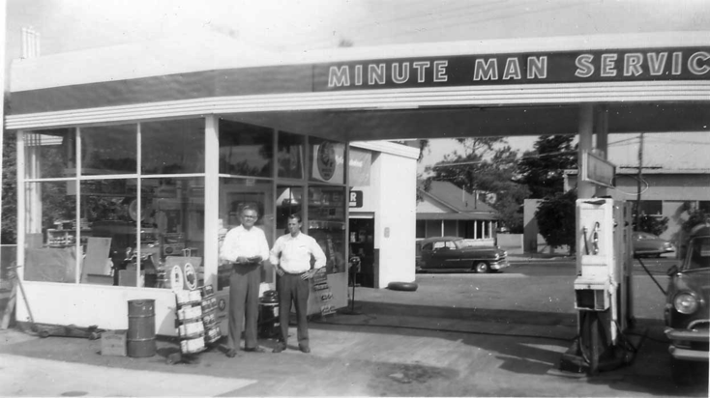
What is a Service
Allows resources to be easily provisioned on-demand
Typically middleware, frameworks, and other “components” necessary for applications
Can be a persistent, stateful layer

Slide 28

Two Types of Services
Managed - Fully integrated, with full lifecycle management
User-Provided – Created and managed external to the platform

Slide 29
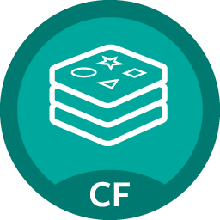
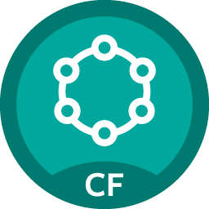

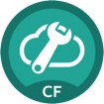
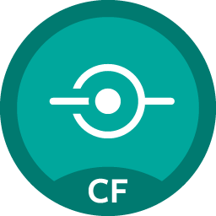


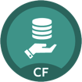
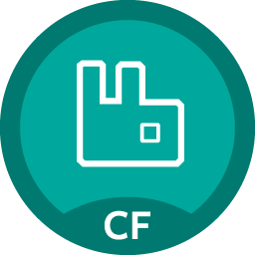
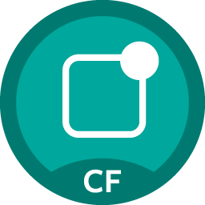

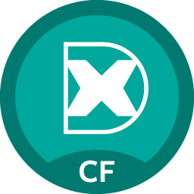



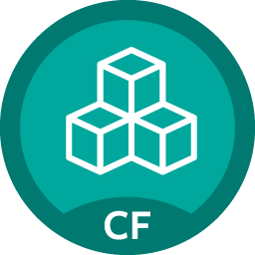

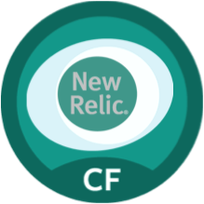

Pivotal Cloud Foundry Services
Mobile
Data
CI/CD
Cloud Native
Redis
DataStax Cassandra
Git Lab
Config Server
API Gateways
Concourse
Service Directory
Push Notifications
MySQL
RabbitMQ
Monitoring
Circuit Breaker
Security
Data Flow
Postgres
App Dynamics
Single Sign-on
MongoDB
PCC
Powered by
New Relic

Slide 30
D e m o
Notes:
“Anatomy of a Buildpack”
Show students a buildpack repo and discuss OSS CF and how each language has a buildpacks that knows how to detect the language as well as compile the droplet.
https://github.com/cloudfoundry/python-buildpack
Compile
Detect: https://github.com/cloudfoundry/python-buildpack/blob/master/bin/detect
Release:

Slide 31
Self provisioning - Creating and Binding a Service
Service
credentials
DB
CLI
create service (HTTP)
Cloud Controller
create service (HTTP)
Service
Broker
reserve resources
Data
Service
Router
bind service (HTTP)
bind service (HTTP)
obtain connection data
Pivotal Cloud Foundry
Elastic Runtime

Slide 32
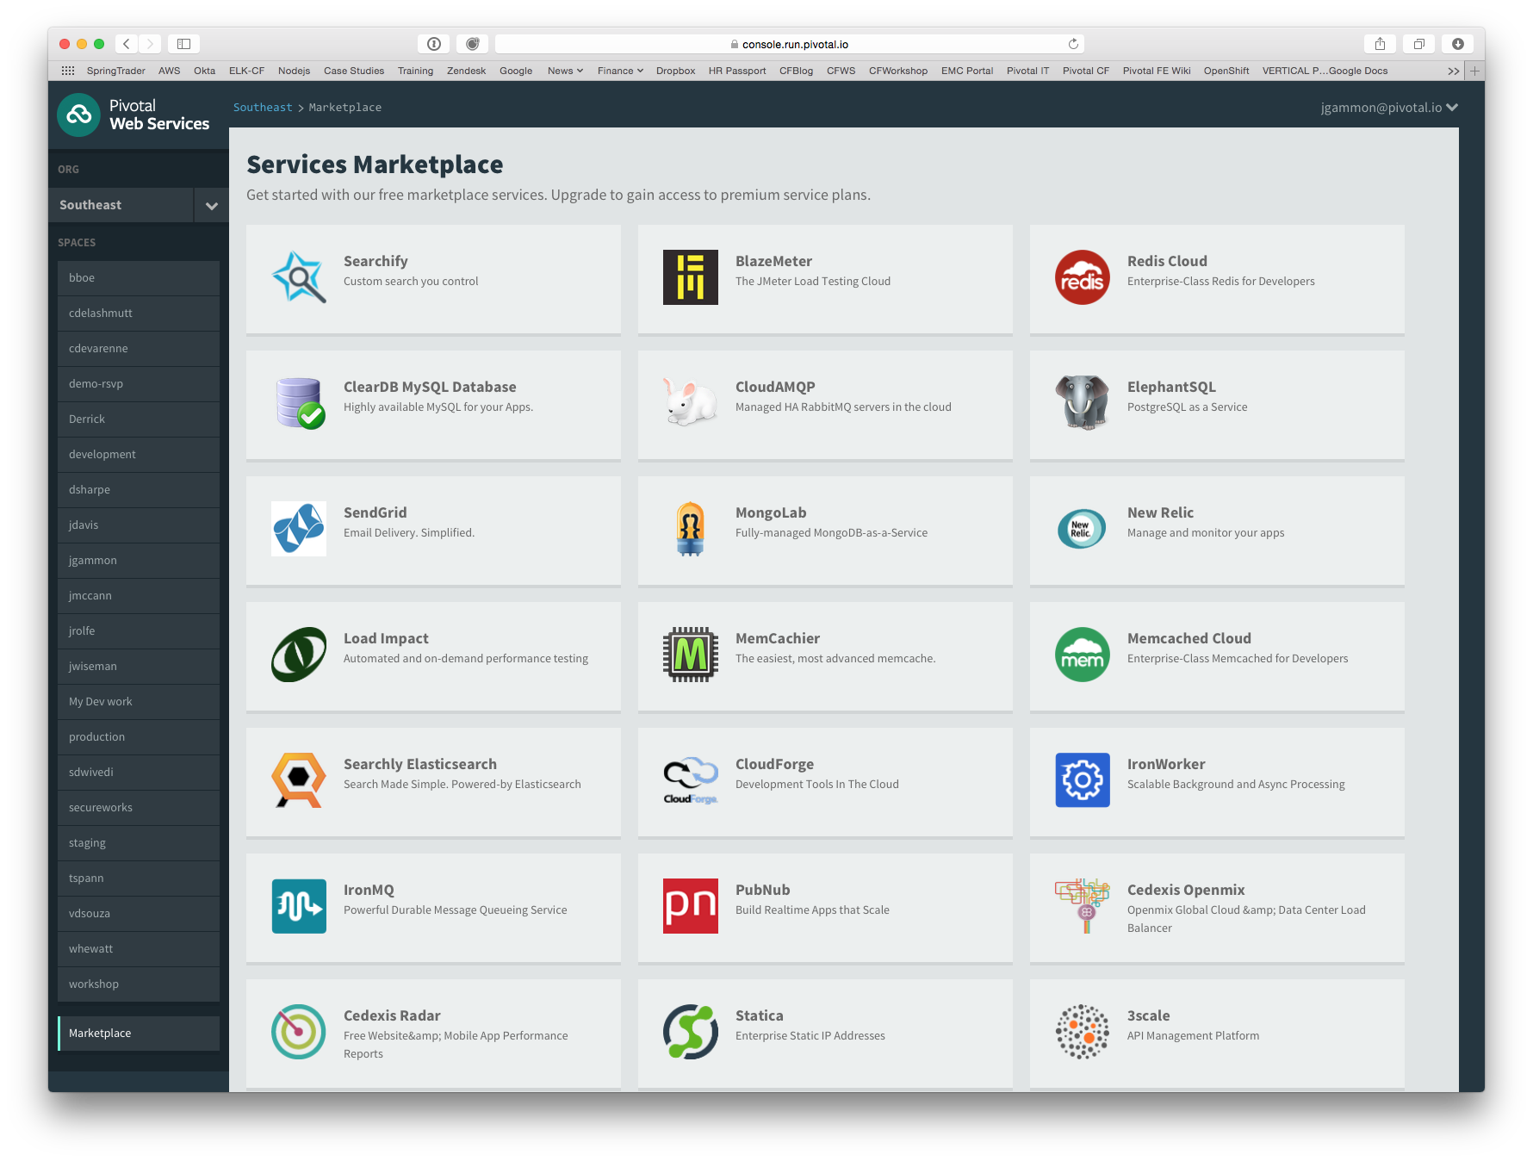
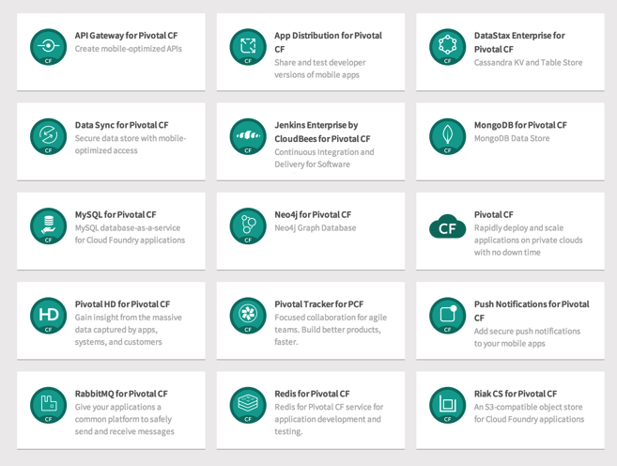
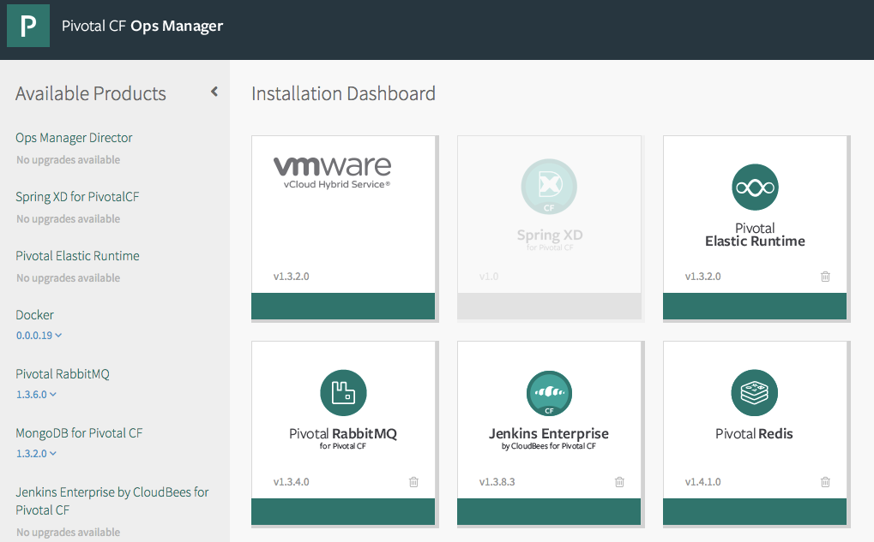
PCF Marketplace
Broad Services Ecosystem
Easy accessibility
Quick, self-provisioning

Slide 33
Pivotal Cloud Foundry
Operations

Slide 34


Pivotal CF operations
Developer
Operator

Slide 35



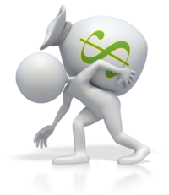
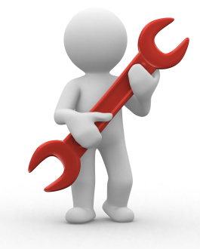





Install runtime and container
Deploy to dev
Install services (db,
messaging, hadoop, …)
Setup load-balancing, SSL termination and dynamic routing
Setup / config
High Availability
App Deployed
Setup APM
Setup log streaming

Slide 36

Blue-green deployment
Restart server
Upgrade app
Deploy to Test
Create service
Deploy to dev
Change JDK
Redeploy
Scale Platform
Scale up
Bind service
Update app
Deploy to QA
Update app server
Unbind service
Change route
Promote to production
Escale memory
Check logs
Scale down
Delete App

Slide 37







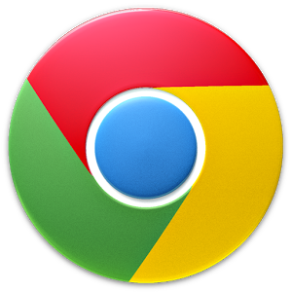
The Pivotal CF Way
Deploy to dev
Cloud
Controller
BBS
> cf push
Router
BRAIN
Access
App Deployed
Loggregator

Slide 38


Operators in the Cloud Native Platform Era

Slide 39



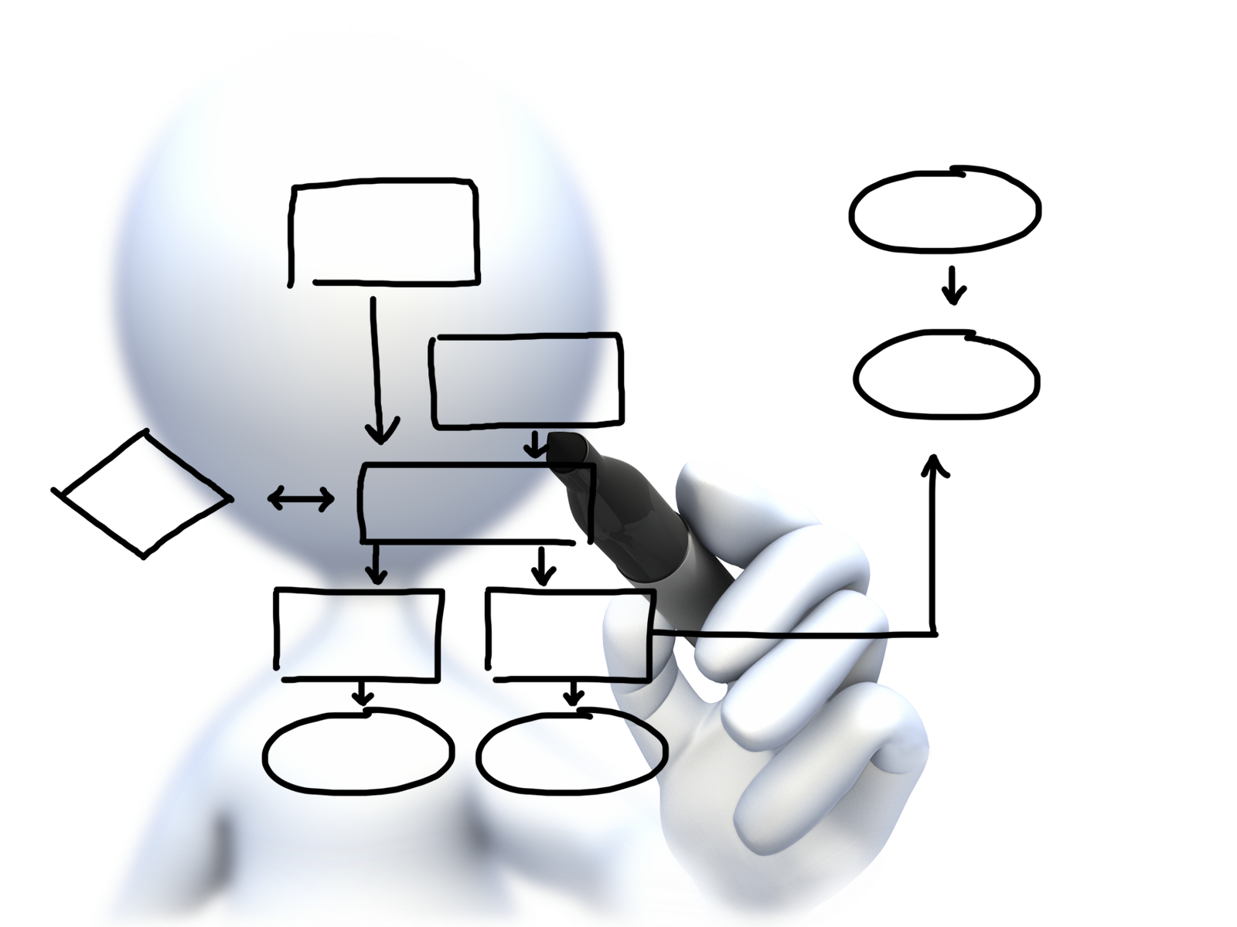


Operator
Concerns
Plan capacity
Setup High Availability
Install the platform
Manage users
and quotas
Handle upgrades and updates
Monitor the platform

Slide 40
Deploying Cloud Foundry
Overview
Notes:
So how many people in here have heard of BOSH?
BOSH is the cloud foundry platform orchestration engine
This is the same BOSH used in open source cloud foundry, making Pivotal, the closest platform to the original CF!
Then you also know how tedious it can be to manage orchestration via manifest files, hence we created Ops Manager to make an easy way to work with it.
http://bosh.io/docs/about.html
https://bosh.io/docs/bosh-components.html

Slide 41
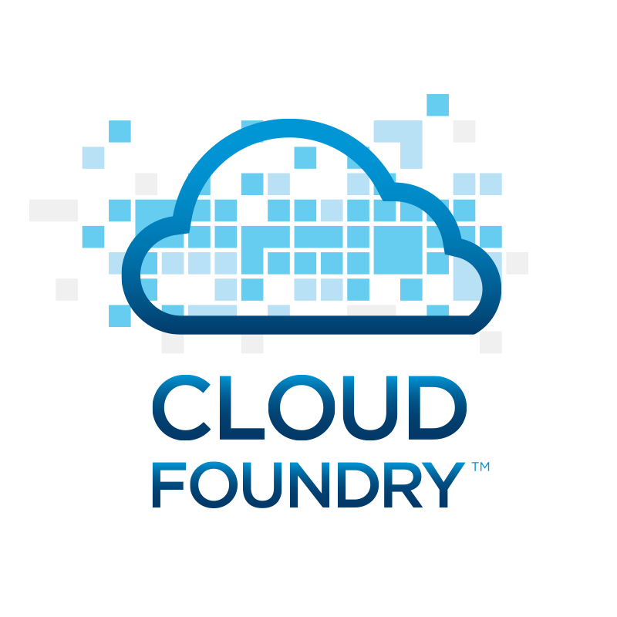


Deploying the CF Runtime with Cloud Foundry BOSH
BOSH
DB
Worker VMs
Deploy new
CF Instance
BOSH Director
Blobstore
etcd
Message Bus
Deployment
Packages
Blobs
Source
Jobs
Manifest
CELL
Health Monitor
Target VM
Cloud Controller
Target VM
Cloud Foundry Operations Manager/BOSH
Target VM
IaaS

Slide 42
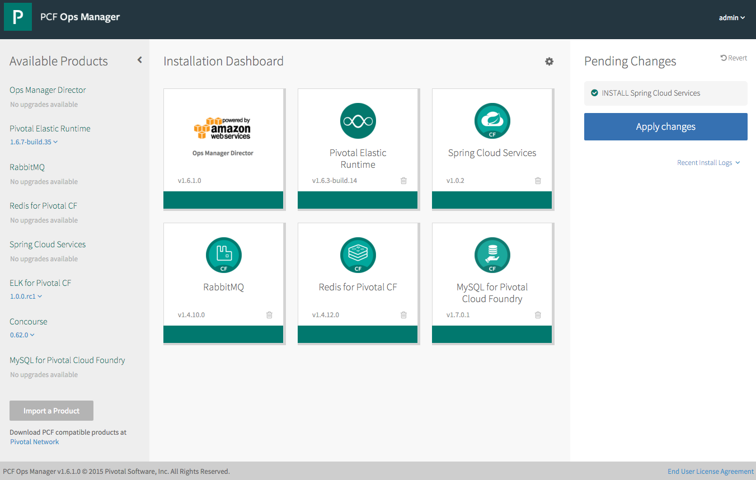
Operations - Pivotal Ops Manager
Click to Install the Platform
Built-in High Availability
Install and Manage Services
Handle Live upgrades and updates
Click to scale the platform
Built-in Platform monitoring
Notes:
http://docs.pivotal.io/pivotalcf/customizing/index.html
This picture allows us to walk thru Ops Manager. Left hand size you see some products that are not installed, you even see a new version of Elastic Rutnime (upgrades) and the Pending Changes (INSTALL Spring Cloud Services). You can talk about important products and the recent logs.
We have the Ops Director for AWS (but we support others). This is the very first tile you install and established the communication with the IaaS. Then you probably start with the Elastic Runtime, now you have a platform – basic platform services including the container runtime (DIEGO). Then you install additional services. All managed by bosh and done in a consistent manager.

Slide 43
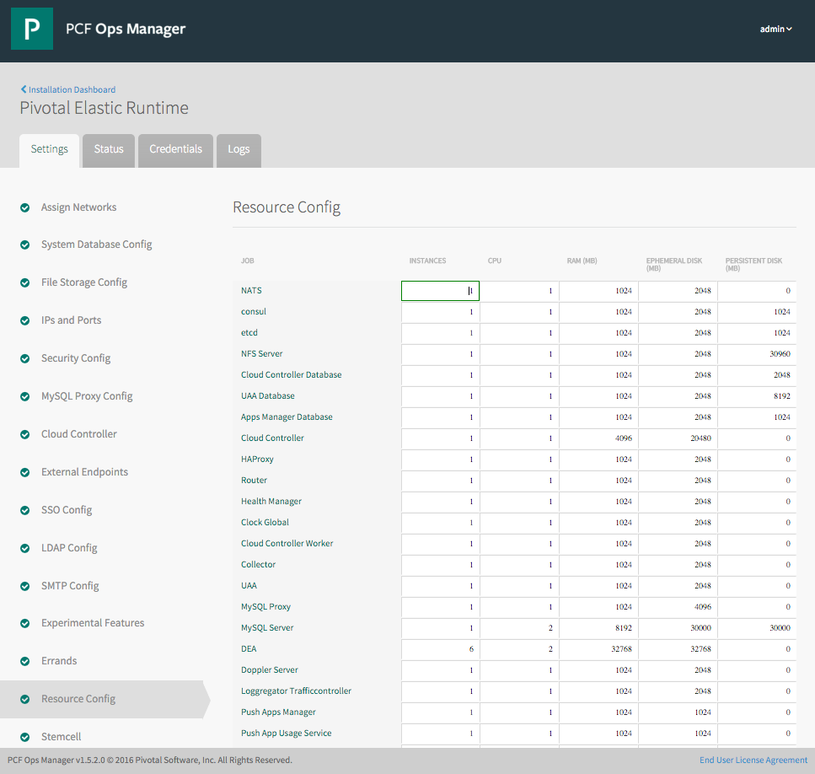
PAS Tile
Web form allowing an operator to scale components both
vertically (CPU, RAM, Disk) and
horizontally (number of instances).
This results in updating the deployment manifest followed by a “bosh deploy.”
Notes:
http://docs.pivotal.io/pivotalcf/customizing/index.html
We can explain quiet a bit on the ERS image. We can highlight the wizard like functionality by showing the settings steps on the left and the monitoring capabilities on the status and logs tabs. We can also talk about credential management for the components of ERS. The setting step selected is the resource config which we can talk about scaling components and HA deployments.

Slide 44
Four Levels of HA
Built In!
Notes:
So how many people in here have heard of BOSH?
BOSH is the cloud foundry platform orchestration engine
This is the same BOSH used in open source cloud foundry, making Pivotal, the closest platform to the original CF!
Then you also know how tedious it can be to manage orchestration via manifest files, hence we created Ops Manager to make an easy way to work with it.
http://bosh.io/docs/about.html
https://bosh.io/docs/bosh-components.html

Slide 45
Four Layers of High Availability – Built In
Application Instance
Platform Processes
Platform VMs
Availability Zones

Slide 46
D e m o
Notes:
High Availability of Scale Demo

Slide 47
Application Instance HA
Blobstore
Cloud Controller
DB
Service
credentials
creds
Cloud Controller Bridge
Actual State
Desired State
Actual State
Re-deploy App
BBS
Converger & Auctioneer
Router
CELL
CELL
CELL
Exec.
Rep
Exec.
Rep
Exec.
Rep
Runtime

Slide 48

Platform Process HA
BBS
AGENT
Restart!
Health Monitor
Responses:
Cell
pager
AGENT
pager
Message Bus
email
email
monitoring
monitoring
…
…
Cloud Controller
AGENT
Pivotal CF Operations Manager
IaaS
Notes:
Two processed on the VMs are MONIT and BOSH agent
Monit monitors the actual state of processes, while BOSH agent is used to communicate the status to the health monitor
In a process goes down, Monit tries to restart it
If successful, or not, BOSH agent is notified, who then tell Health monitor, which will notify the operator
The processes running on the virtual machines (i.e. the health manager) are started with monit, an opensource linux utility that keeps an eye on processes and will respond when one dies. If a process dies then, monit will do two things: first, it will try to restart the process and second, whether the restart is successful or not, it will tell the BOSH agent about the failure. Recall that the Bosh agent is there to communicate with Operations Manager and in this case it will relay this failure information to the Operations Manager Health Monitor (not to be confused with the Health Manager of the elastic runtime that was discussed above) – we’ll abbreviate it OMHM. The OMHM will take this alert and pass it through a list of responders that can be configured to do things like send emails, page administrators and display alerts in operations dashboards. There’s a good chance that monit will already have recovered the process, but we also want there to be an opportunity for a human to respond.

Slide 49

Platform Virtual Machine HA
Cloud Controller
DB
Agent
Process
BOSH Director
Health Manager
Blobstore
Re-create VM
Agent
Process
Ressurector
BBS
VM is
missing…
Agent
Process
Message Bus
Health
Monitor
Cloud Controller
Agent
Process
Pivotal CF Operations Manager
IaaS

Slide 50
Availability Zone HA
Zone 1
Zone 2
Availability Zones are vCenter Resource Pools
Cell
Cell
System components and Application instances are evenly distributed over two availability zones.
Cell
Cell
Router
Cell
Cell
Loosing an AZ keeps instances running and available.
Notes:
Zone could = rack, for example

Slide 51
3 Rs to address top 3 security threats
Repair
Rotate
Repave

Slide 52
Platform Upgrades and Patches
BOSH executes Canary-style deployments to minimize downtime
Also known as rolling upgrades
A select number of “canary” VMs from the new release are deployed
BOSH verifies new VMs have been deployed successfully
Remaining VMs are deployed only if the upgrade of canary VMs succeeded
Otherwise the upgrade is halted

Slide 53
Upgrade and patch with rolling “canary” deploys
A
B
M
N
X
Y
A,B,M,N,X,Y
- Application instances
- VM prior to update
Notes:
The other great thing about PCF infrastructure automation isr rolling or canary style zero downtime updates.
[[Ask: Does everyone know about the statement canary in the coal mine? If not, explain what that is]].
Upgrades and patches are introduced to PCF based on the canary model. The application instances are moved off the trial VMs and deployed elsewhere and user traffic is routed there. The patch or upgrade is applied to the now “empty” trial VMs and if that passes, the VM is ready to accept new application instances. The changes are rolled through in batches all the while redeploying applications and seamlessly rerouting traffic to available instances until the system is returned to consistency with the update fully applied. Our infrastructure automation layer gives operators ability to update the operating system that’s embedded into platform.

Slide 54
Upgrade and patch with rolling “canary” deploys
A
B
M
N
X
Y
A
B
M
X
N
Y
Apps redeployed to clear VMs
Notes:
The other great thing about PCF infrastructure automation isr rolling or canary style zero downtime updates.
[[Ask: Does everyone know about the statement canary in the coal mine? If not, explain what that is]].
Upgrades and patches are introduced to PCF based on the canary model. The application instances are moved off the trial VMs and deployed elsewhere and user traffic is routed there. The patch or upgrade is applied to the now “empty” trial VMs and if that passes, the VM is ready to accept new application instances. The changes are rolled through in batches all the while redeploying applications and seamlessly rerouting traffic to available instances until the system is returned to consistency with the update fully applied. Our infrastructure automation layer gives operators ability to update the operating system that’s embedded into platform.

Slide 55
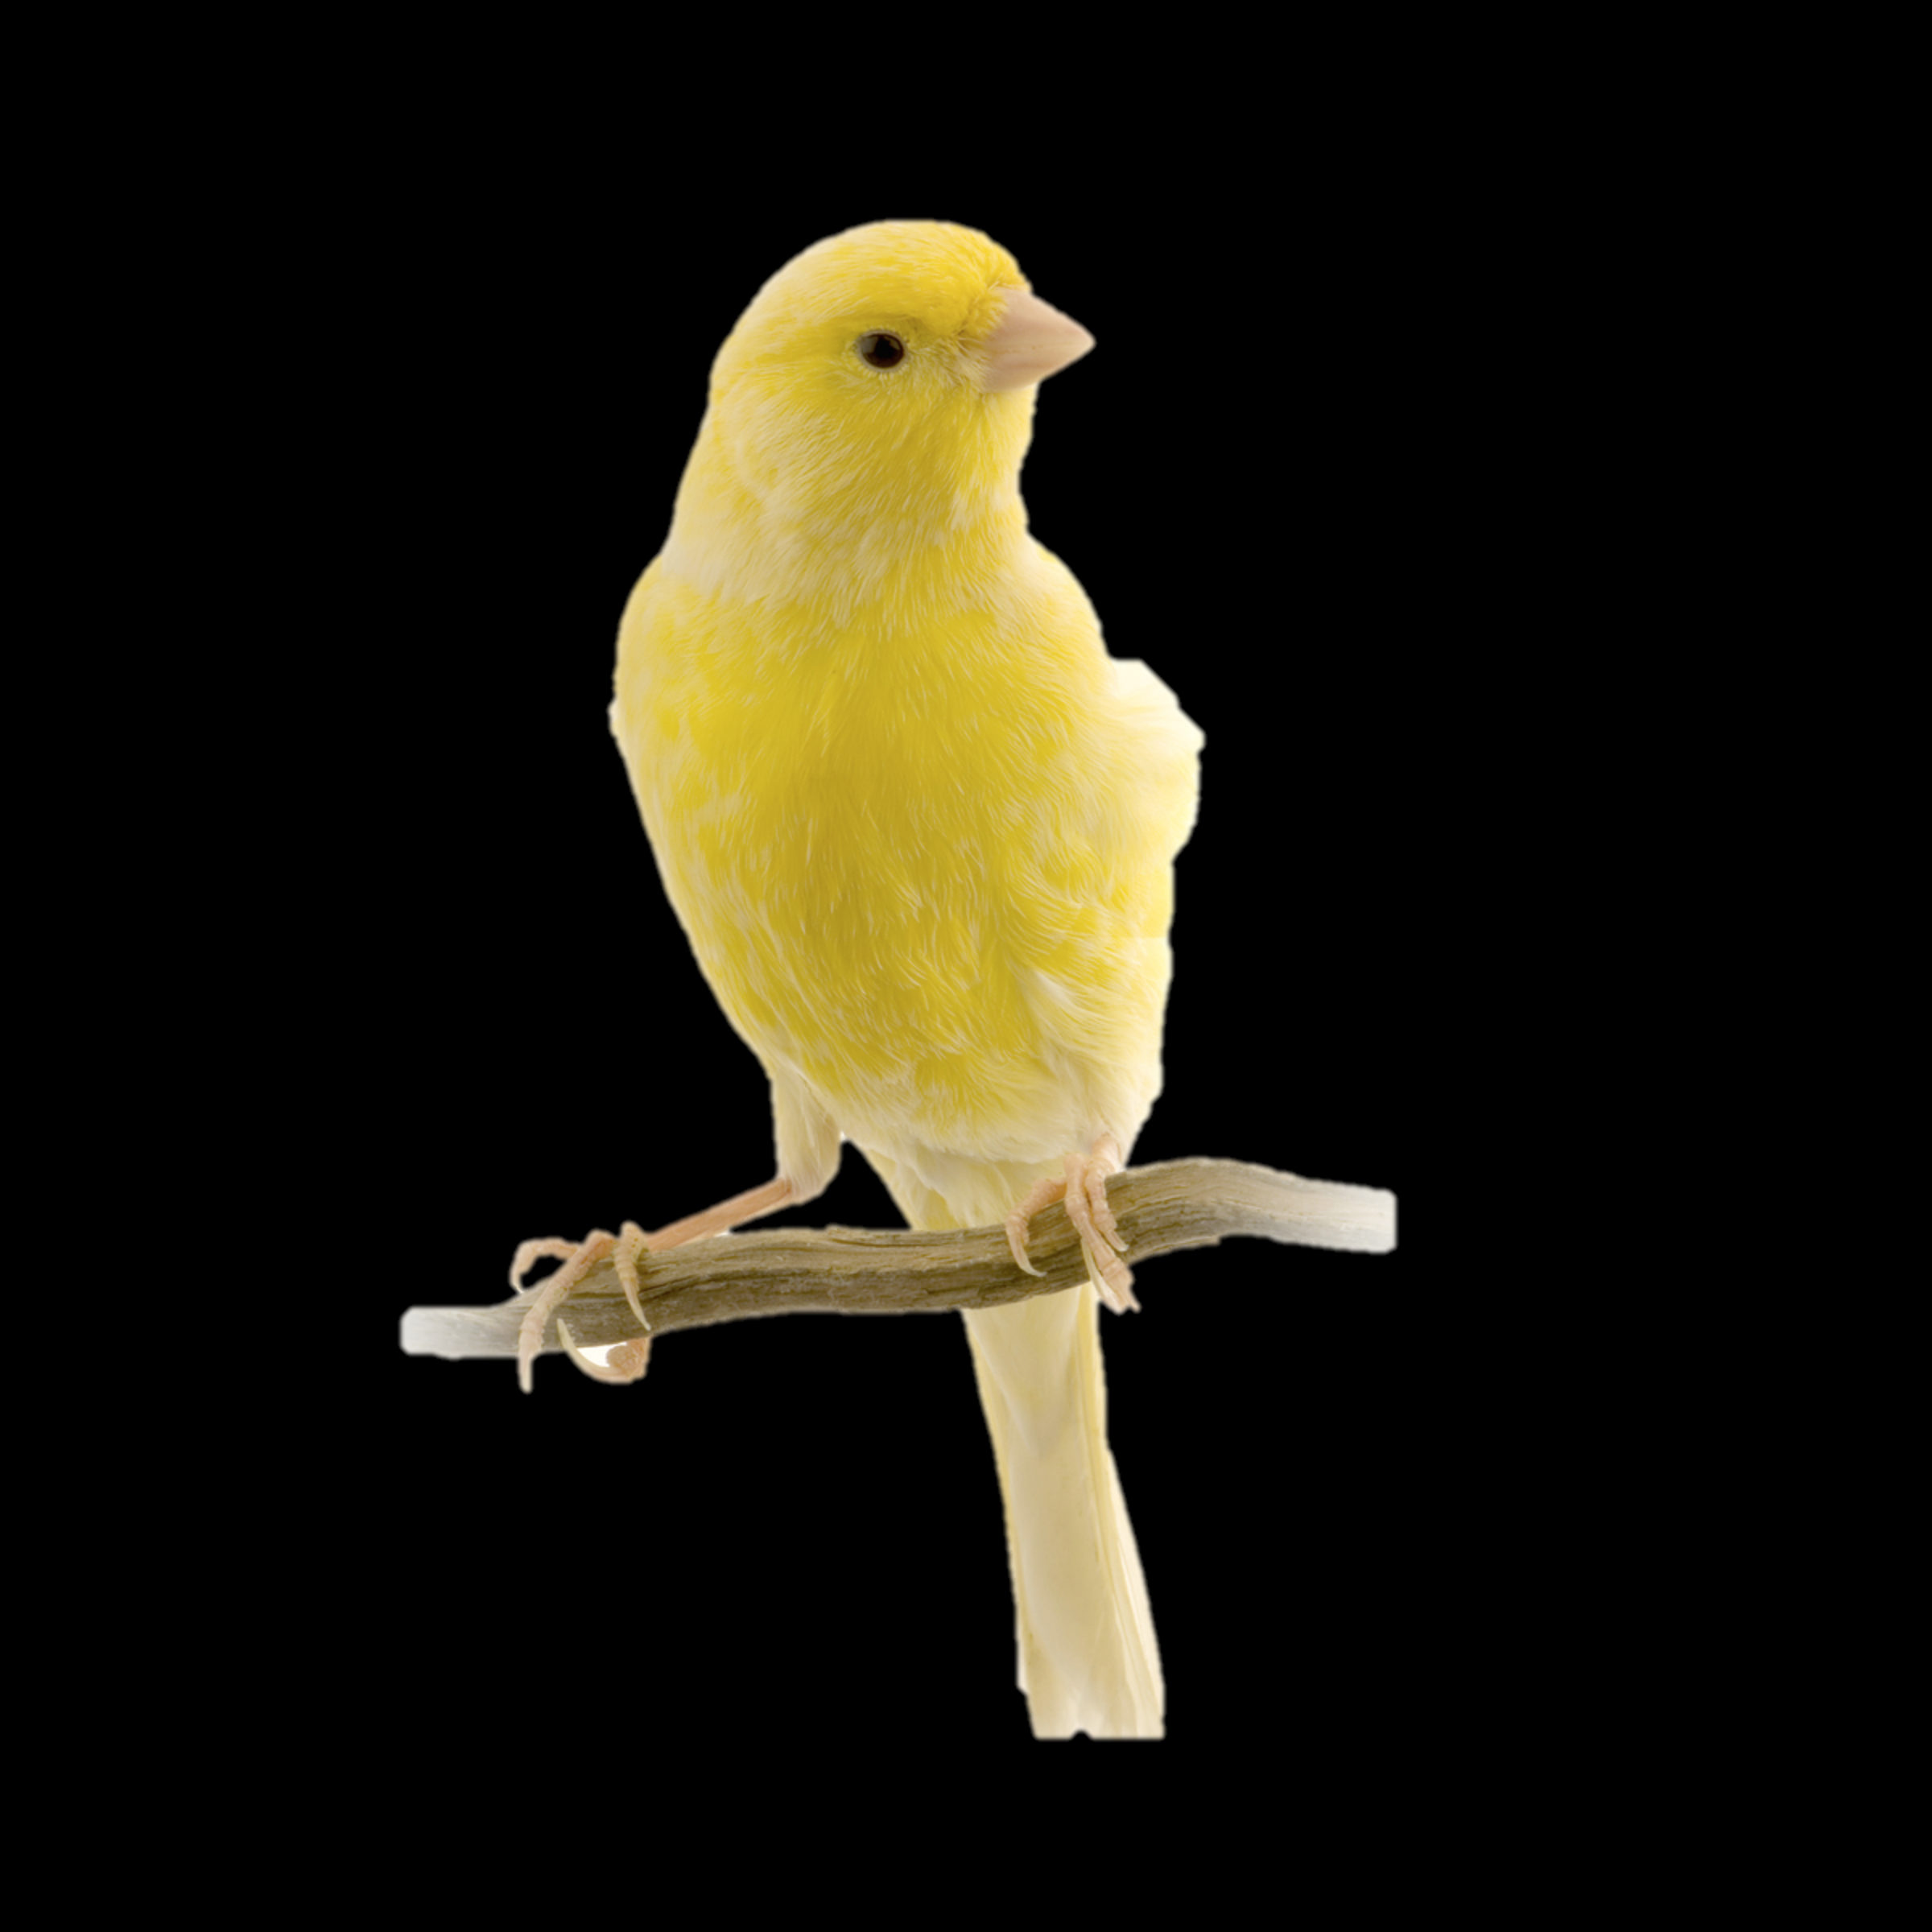
Upgrade and patch with rolling “canary” deploys
A
B
M
N
X
Y
A
B
M
X
N
Y
A
B
M
X
N
Y
Update introduced. If the tests pass, keep going
Notes:
The other great thing about PCF infrastructure automation isr rolling or canary style zero downtime updates.
[[Ask: Does everyone know about the statement canary in the coal mine? If not, explain what that is]].
Upgrades and patches are introduced to PCF based on the canary model. The application instances are moved off the trial VMs and deployed elsewhere and user traffic is routed there. The patch or upgrade is applied to the now “empty” trial VMs and if that passes, the VM is ready to accept new application instances. The changes are rolled through in batches all the while redeploying applications and seamlessly rerouting traffic to available instances until the system is returned to consistency with the update fully applied. Our infrastructure automation layer gives operators ability to update the operating system that’s embedded into platform.

Slide 56

Upgrade and patch with rolling “canary” deploys
A
B
M
N
X
Y
A
B
M
X
N
Y
A
B
M
X
N
Y
Apps redeployed to updated VMs
A
B
M
X
N
Y
Notes:
The other great thing about PCF infrastructure automation isr rolling or canary style zero downtime updates.
[[Ask: Does everyone know about the statement canary in the coal mine? If not, explain what that is]].
Upgrades and patches are introduced to PCF based on the canary model. The application instances are moved off the trial VMs and deployed elsewhere and user traffic is routed there. The patch or upgrade is applied to the now “empty” trial VMs and if that passes, the VM is ready to accept new application instances. The changes are rolled through in batches all the while redeploying applications and seamlessly rerouting traffic to available instances until the system is returned to consistency with the update fully applied. Our infrastructure automation layer gives operators ability to update the operating system that’s embedded into platform.

Slide 57
Upgrade and patch with rolling “canary” deploys
A
B
M
N
X
Y
A
B
M
X
N
Y
A
B
M
X
N
Y
A
B
M
X
N
Y
A
B
M
X
N
Y
Remaining VMs updated same way
Notes:
The other great thing about PCF infrastructure automation isr rolling or canary style zero downtime updates.
[[Ask: Does everyone know about the statement canary in the coal mine? If not, explain what that is]].
Upgrades and patches are introduced to PCF based on the canary model. The application instances are moved off the trial VMs and deployed elsewhere and user traffic is routed there. The patch or upgrade is applied to the now “empty” trial VMs and if that passes, the VM is ready to accept new application instances. The changes are rolled through in batches all the while redeploying applications and seamlessly rerouting traffic to available instances until the system is returned to consistency with the update fully applied. Our infrastructure automation layer gives operators ability to update the operating system that’s embedded into platform.

Slide 58
Upgrade and patch with rolling “canary” deploys
A
B
M
N
X
Y
A
B
M
X
N
Y
A
B
M
X
N
Y
A
B
M
X
N
Y
A
B
M
X
N
Y
A
B
M
X
N
Y
Automated, No downtime
Atomic rolling update
Notes:
The other great thing about PCF infrastructure automation isr rolling or canary style zero downtime updates.
[[Ask: Does everyone know about the statement canary in the coal mine? If not, explain what that is]].
Upgrades and patches are introduced to PCF based on the canary model. The application instances are moved off the trial VMs and deployed elsewhere and user traffic is routed there. The patch or upgrade is applied to the now “empty” trial VMs and if that passes, the VM is ready to accept new application instances. The changes are rolled through in batches all the while redeploying applications and seamlessly rerouting traffic to available instances until the system is returned to consistency with the update fully applied. Our infrastructure automation layer gives operators ability to update the operating system that’s embedded into platform.

Slide 59

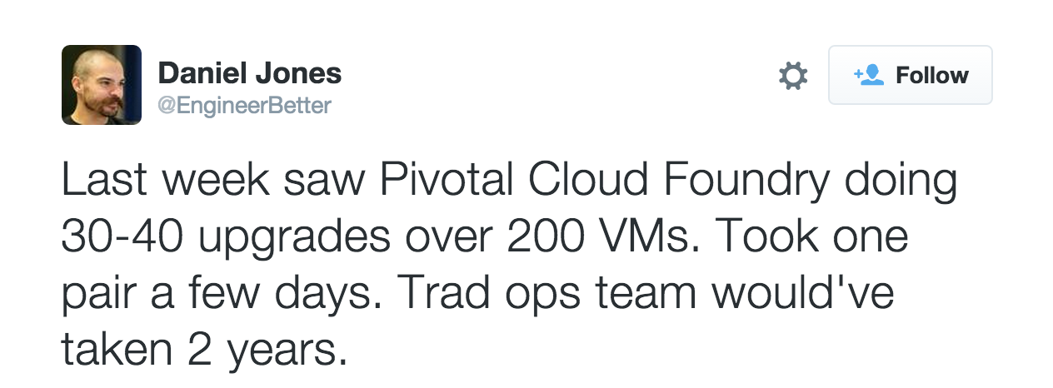

Upgrade and patch with rolling “canary” deploys
Notes:
This comes in pretty handy because lately it seems like we’re getting hit with so many CVE’s. When heartbleed virus hit, our customers took our patch and using canary deploys the fix ran itself across all the VMs under PCF in the data center. All they used was our GUI and 2 easy commands.
Talk track covers how its manual w/ Docker.

Slide 60








Click to install
No downtime updates
Explore install logs
Pivotal Elastic Runtime
MYSQL for
Pivotal CF
App Autoscaling
Pivotal Ops Metrics
RabbitMQ for
Pivotal CF
Riak CS for
Pivotal CF
Click to scale the platform
Pivotal Redis
Spring Cloud Services
CloudBees Jenkins for Pivotal CF
Built-in High Availability
Cassandra for Pivotal CF
Pivotal HD for Pivotal CF
GitLab for
Pivotal CF
Built-in Platform Monitoring
Elastic Search for Pivotal CF
Mobile Services for Pivotal CF
Spring Cloud
Data Flow
BOSH Director
BOSH Agent
Integrated services
IaaS
Azure

Slide 61

Transforming How The World Builds Software
© Copyright 2017 Pivotal Software, Inc. All rights Reserved.

Slide 62
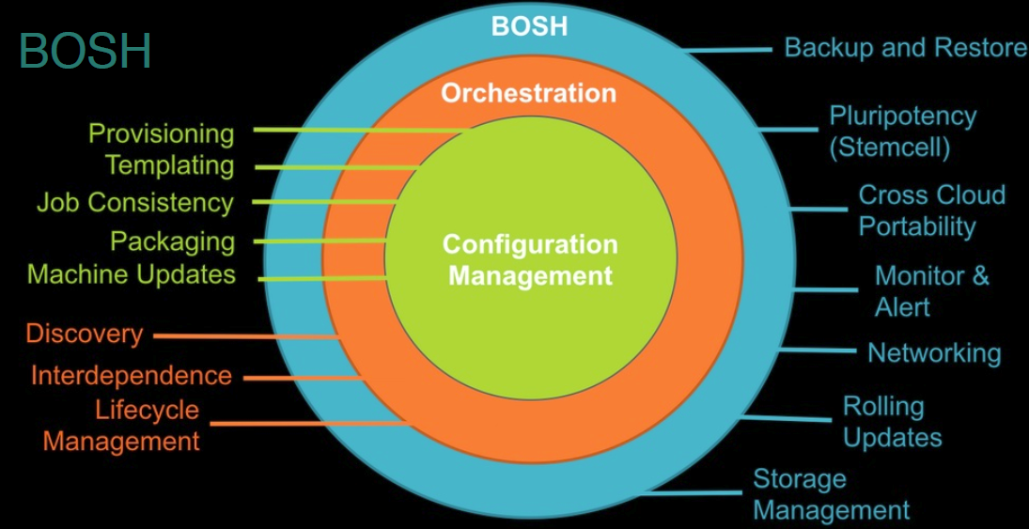
BOSH?

